Slide 1
Statistics for machine learning (Day-2)
Siva
Basic Stats - Mean, Variance, SD, Exploratory Analysis and Plots, Covariance, Correlation, Probability
“There are three kinds of lies -- lies, damned lies, and statistics.” This quote reminds us why it is so important to understand statistics

Slide 2
Statistics
Statistics is the methodology which scientists and mathematicians have developed for interpreting and drawing conclusions from collected data.
Historically, the ideas and methods of statistics developed gradually as society grew interested in collecting and using data for a variety of applications.
The earliest origins of statistics lie in the desire of rulers to count the number of inhabitants or measure the value of taxable land in their domains.
By the nineteenth century, the agricultural, life, and behavioral sciences also began to rely on data to answer fundamental questions.
How are the heights of parents and children related?
Does a new variety of wheat produce higher yields than the old, and under what conditions of rainfall and fertilizer?
Can a person’s mental ability and behavior be measured just as we measure height
and reaction time?

Slide 3
Exploratory data analysis(EDA)
“EDA" is a critical first step in analyzing the data from an experiment. Here are the main reasons we use EDA:
detection of mistakes
checking of assumptions
preliminary selection of appropriate models
determining relationships among the explanatory variables, and
assessing the direction and rough size of relationships between explanatory
and outcome variables.
People are not very good at looking at a column of numbers or a whole spread- sheet and then determining important characteristics of the data. They ‘d find looking at numbers to be tedious, boring, and/or overwhelming. Exploratory data analysis techniques have been devised as an aid in this situation.

Slide 4
EDA
Exploratory data analysis is generally classified in two ways.
First, each method is either non-graphical or graphical.
And second, each method is either univariate or multivariate (usually just bivariate).
The four types of EDA are univariate non-graphical, multivariate non-graphical, univariate graphical, and multivariate graphical.
The data that come from making a particular measurement on all of the subjects in a sample represent our observations for a single characteristic such as age, gender, speed at a task, or response to a stimulus.
We should think of these measurements as representing a sample distribution" of the variable, which in turn more or less represents the population distribution" of the variable.

Slide 5
Types of data
Different types of data:
Numerical data: data that are basically numbers. Ex: Temperature, sales etc.,
Categorical data:
Categorical data represent characteristics such as a person’s gender, marital status, hometown, or the types of movies they like.
Categorical data can take on numerical values (such as “1” indicating male and “2” indicating female), but those numbers don’t have mathematical meaning. You couldn’t add them together, for example. (Other names for categorical data are qualitative data, or Yes/No data.)
Ordinal data
Ordinal data is a categorical, statistical data type where the variables have natural, ordered categories and the distances between the categories is not known. (rating the performance of a restaurant).

Slide 6
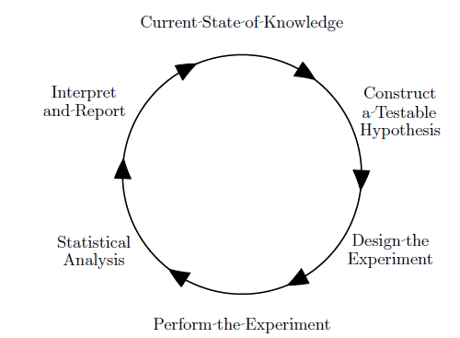
Scientific learning is always an iterative process,
If we start at Current State of Knowledge, the next step is choosing a current theory to test or explore (or proposing a new theory).
This step is often called “Constructing a Testable Hypothesis". Any hypothesis must allow for different possible conclusions or it is pointless.

Slide 7
Statistical models
Most formal (confirmatory) statistical analyses are based on models. Statistical models are ideal, mathematical representations of observable characteristics.
Models are best divided into two components. The structural component of the model (or structural model) species the relationships between explanatory variables and the mean (or other key feature) of the outcome variables.
The “random" or “error" component of the model (or error model) characterizes the deviations of the individual observations from the mean. (Here, “error" does not indicate “mistake".) The two model components are also called “signal" and “noise" respectively.

Slide 8
Types of data
Quantitative Variables
Data that are basically numbers. Ex: Temperature, sales etc.,
Discrete Variables: Sales quantity of Books
Continuous Variables: Temperature, pressure
Categorical Variables
Categorical data represent characteristics such as a person’s gender, marital status, hometown, or the types of movies they like.
Categorical data can take on numerical values (such as “1” indicating male and “2” indicating female), but those numbers don’t have mathematical meaning. You couldn’t add them together, for example. (Other names for categorical data are qualitative data, or Yes/No data.)
Ordinal data
Ordinal data is a categorical, statistical data type where the variables have natural, ordered categories and the distances between the categories is not known. (rating the performance of a restaurant).
Nominal data
Nominal data can’t be ordered in any way.
Subtraction test is used to distinguish between Nominal and Ordinal variables.
Clue: White = 1, Red = 2; Blue = 3. Analyze the problem.

Slide 9
Population and sample
In the context of experiments, observational studies, and surveys, we make our actual measurements on individual observational units.
Population
We use the term population to refer to the entire set of actual or potential observational units.
Sample:
For most studies (other than a census), only a subset of all of the possible experimental units of the population are actually selected for study, and this is called the sample (not to be confused with sample space).
An important part of the understanding of the idea of a sample is to realize that each experiment is conducted on a particular sample, but might have been conducted on many other different samples.
In other words,
Population and sample are two basic concepts of statistics. Population can be characterized as the set of individual persons or objects in which an investigator is primarily interested during his or her research problem.
Sometimes wanted measurements for all individuals in the population are obtained, but often only a set of individuals of that population are observed; such a set of individuals constitutes a sample.

Slide 10
Two types in statistics
Descriptive statistics
These are numbers that are used to summarize and describe data.
Inferential:
Inferential statistics (both estimation and hypothesis testing) refers to the drawing of generalizations about the properties of the whole (called a population) from the specific or a sample drawn from the population. Inferential statistics thus involves inductive reasoning.

Slide 11
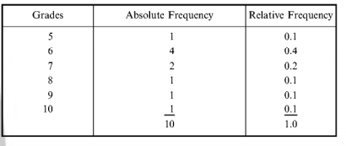
Data representation: Frequency representation
Example:
A student receives following grades in 10 quizzes.
6,7,6,8,5,7,6,9,10 and 6.
Now, these numbers can be arranged as
The absolute frequency essentially indicates ‘the number of times’ a same data element appears. Relative frequency essentially gives the ration of the frequency to the total.
Exercise:
The R command hist(data matrix(grades, absolute frequency) draws the diagram called Histogram.

Slide 12
Measures of Center - Plotting data in a frequency distribution shows the general shape of the distribution and gives a general sense of how the numbers are bunched. Several statistics can be used to represent the "center" of the distribution. These statistics are commonly referred to as measures of central tendency. Mode – The mode of a distribution is simply defined as the most frequent or common score in the distribution. The mode is the point or value of X that corresponds to the highest point on the distribution. If the highest frequency is shared by more than one value, the distribution is said to be multimodal. It is not uncommon to see distributions that are bimodal reflecting peaks in scoring at two different points in the distribution.
Measures in statistics - Measures of center

Slide 13
Mean and Median
Median - The median is the score that divides the distribution into halves; half of the scores are above the median and half are below it when the data are arranged in numerical order.
The median is also referred to as the score at the 50th percentile in the distribution.
The median location of N numbers can be found by the formula (N + 1) / 2. When N is an odd number, the formula yields a integer that represents the value in a numerically ordered distribution corresponding to the median location.
For example, in the distribution of numbers (3 1 5 4 9 9 8) the median location is (7 + 1) / 2 = 4.
When applied to the ordered distribution (1 3 4 5 8 9 9), the value 5 is the median, three scores are above 5 and three are below 5. If there were only 6 values (1 3 4 5 8 9), the median location is (6 + 1) / 2 = 3.5. In this case the median is half-way between the 3rd and 4th scores (4 and 5) or 4.5.
Mean - The mean is the most common measure of central tendency and the one that can be mathematically manipulated.
It is defined as the average of a distribution is equal to the SX / N. Simply, the mean is computed by summing all the scores in the distribution (SX) and dividing that sum by the total number of scores (N).
The mean is the balance point in a distribution such that if you subtract each value in the distribution from the mean and sum all of these deviation scores, the result will be zero.

Slide 14
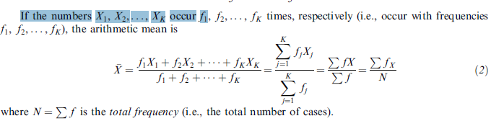
Mean
There are different types of means.
i) Arithmetic mean: Sum up the values and divide by te count.
The arithmetic mean, or briefly the mean, of a set of N numbers X1, X2, X3, . . . ,XN is denoted by Xbar and is defined as
(Σ₁^{N} xi ) /N.
The sum of the squares of the deviations of a set of numbers Xj from any number a is a minimum if and only if a = Xbar (mean)

Slide 15
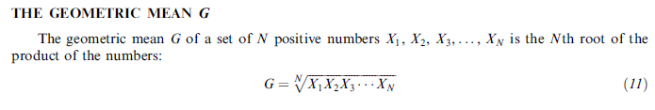
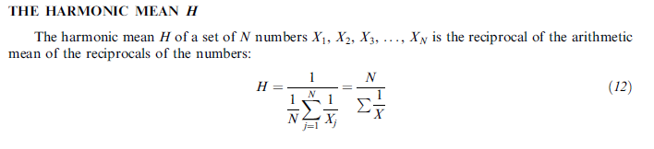
Geometric and Harmonic means
Mode of a set of numbers is the value which occurs at highest frequency.
An empirical relation is given by
Mean – mode = 3(mean – median).

Slide 16
Robustness of statistical measures
The mode should be used when calculating measure of center for the qualitative variable.
When the variable is quantitative with symmetric distribution, then the mean is proper measure of center.
In a case of quantitative variable with skewed distribution, the median is good choice for the measure of center.
This is related to the fact that the mean can be highly influenced by an observation that falls far from the rest of the data, called an outlier

Slide 17
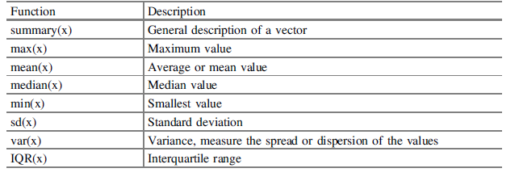
R Statistical commands

Slide 18
Quartiles, deciles and percentiles
If a set of data is arranged in order of magnitude, the middle value (or arithmetic mean of the two middle values) that divides the set into two equal parts is the median.
By extending this idea, we can think of those values which divide the set into four equal parts. These values, denoted by Q1, Q2, and Q3, are called the first, second, and third quartiles, respectively, the value Q2 being equal to the median.
Similarly, the values that divide the data into 10 equal parts are called deciles and are denoted by D1,D2, . . . , D9, while the values dividing the data into 100 equal parts are called percentiles and are denoted by P1, P2, . . . , P99. The fifth decile and the 50th percentile correspond to the median. The 25th and 75th percentiles correspond to the first and third quartiles, respectively.

Slide 19
Application of Box plot – Outlier detection

Slide 20
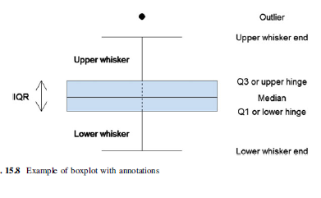
Application of Box plot – Outlier detection

Slide 21
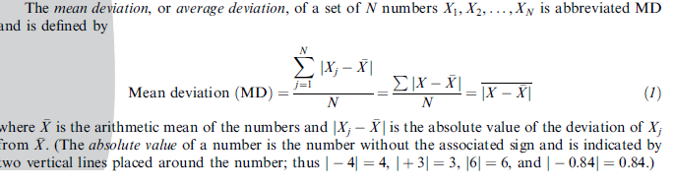
Measures of spread
Measures of Spread - Although the average value in a distribution is informative about how scores are centered in the distribution, the mean, median, and mode lack context for interpreting those statistics.
Measures of variability provide information about the degree to which individual scores are clustered about or deviate from the average value in a distribution.
Range - The simplest measure of variability to compute and understand is the range. The range is the difference between the highest and lowest score in a distribution. Although it is easy to compute, it is not often used as the sole measure of variability due to its instability. Because it is based solely on the most extreme scores in the distribution and does not fully reflect the pattern of variation within a distribution, the range is a very limited measure of variability.
The mean deviation:

Slide 22
Quartiles
Interquartile Range (IQR) - Provides a measure of the spread of the middle 50% of the scores.
The IQR is defined as the 75th percentile - the 25th percentile. The interquartile range plays an important role in the graphical method known as the boxplot.
The advantage of using the IQR is that it is easy to compute and extreme scores in the distribution have much less impact but its strength is also a weakness in that it suffers as a measure of variability because it discards too much data. Researchers want to study variability while eliminating scores that are likely to be accidents. The boxplot allows for this for this distinction and is an important tool for exploring data.

Slide 23
Variance and standard deviation
Variance - The variance is a measure based on the deviations of individual scores from the mean.
As noted in the definition of the mean, however, simply summing the deviations will result in a value of 0.
To get around this problem the variance is based on squared deviations of scores about the mean. When the deviations are squared, the rank order and relative distance of scores in the distribution is preserved while negative values are eliminated.
Then to control for the number of subjects in the distribution, the sum of the squared deviations, Σ(X - ‾X^{)2,} is divided by N (population) or by N - 1 (sample).
The result is the average of the sum of the squared deviations and it is called the variance.

Slide 24
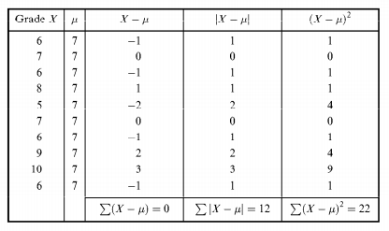
Variance calculations
Data:
The grades of 10 students are given as ( 6,7,6,8,5,7,6,9,10,6). Compute the variance.

Slide 25

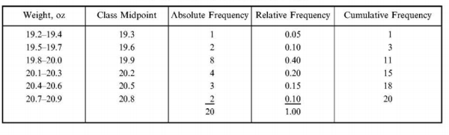
Recollect:
The cans in a sample of 20 cans of fruit contain net weights of fruit ranging from 19.3 to 20.9 oz, as given in the table. If we want to group these data into 6 classes, we get class intervals of 0.302 [(2 1.0 - 19.2) 16 = 0.3 oz]. The weights given in Table 1 can be arranged into the frequency distributions given in Table 2 and shown graphically in figures 3 and 4.
Figure 1:

Slide 26
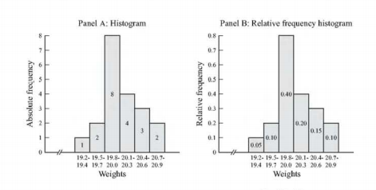
Histogram representaiton

Slide 27
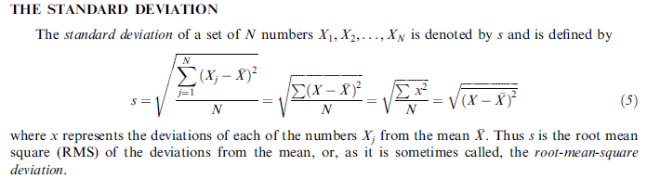
Standard deviation
Standard deviation - The standard deviation (s or σ) is defined as the positive square root of the variance.
The variance is a measure in squared units and has little meaning with respect to the data. Thus, the standard deviation is a measure of variability expressed in the same units as the data.
The standard deviation is very much like a mean or an "average" of these deviations.
In a normal (symmetric and mound-shaped) distribution, about two-thirds of the scores fall between +1 and -1 standard deviations from the mean and the standard deviation is approximately 1/4 of the range in small samples (N < 30) and 1/5 to 1/6 of the range in large samples (N > 100).

Slide 28
Dimensionless ratios
The actual variation should be related to the scale of magnitudes. With average as reference
relative dispersion = absolute dispersion/average
In case of dispersion being standard deviation, the relative dispersion = standard deviation / average.
For a given set of data X with mean Xbar, the deviation is X- Xbar.
X-Xbar in units of standard deviation is defined as standardized score.

Slide 29
Application – Portfolio optimization (Nobel winning contribution)
Just with variance and mean, the mathematical optimization led to one of the popular – most useful application got developed.
In a stock market, there are many different investments possible.
Each investment can give some expected profit with possible variation
Based on the past data, variance of stock prices (with some aggregation) can be evaluated.

Slide 30
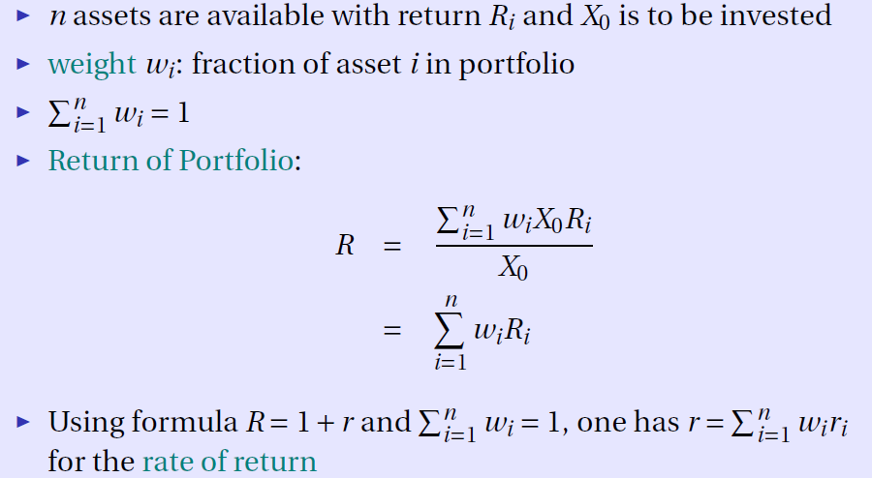

Slide 31
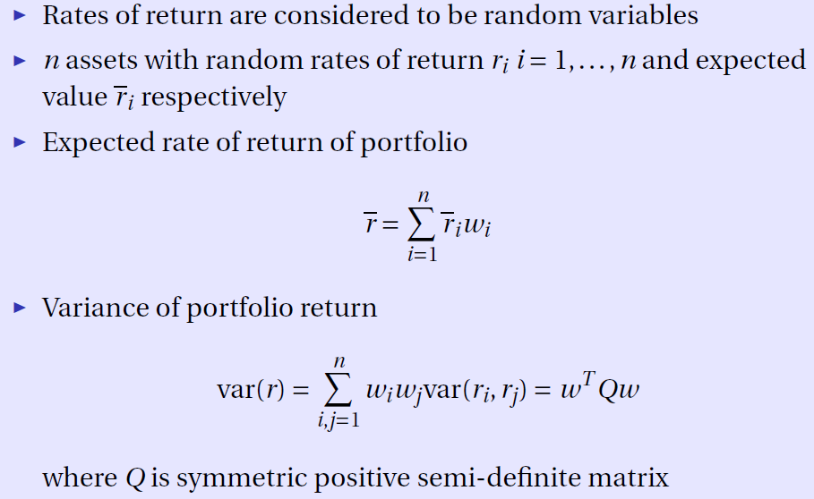

Slide 32
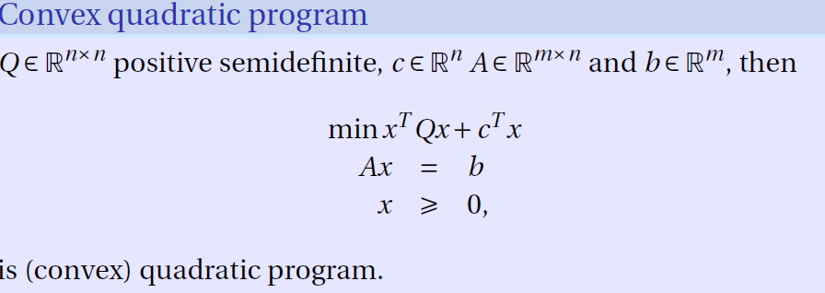
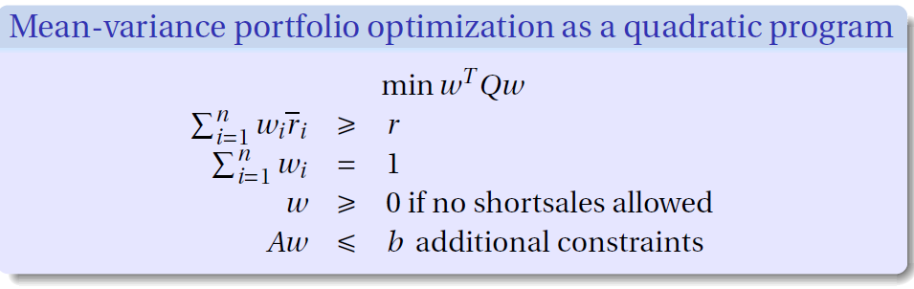

Slide 33
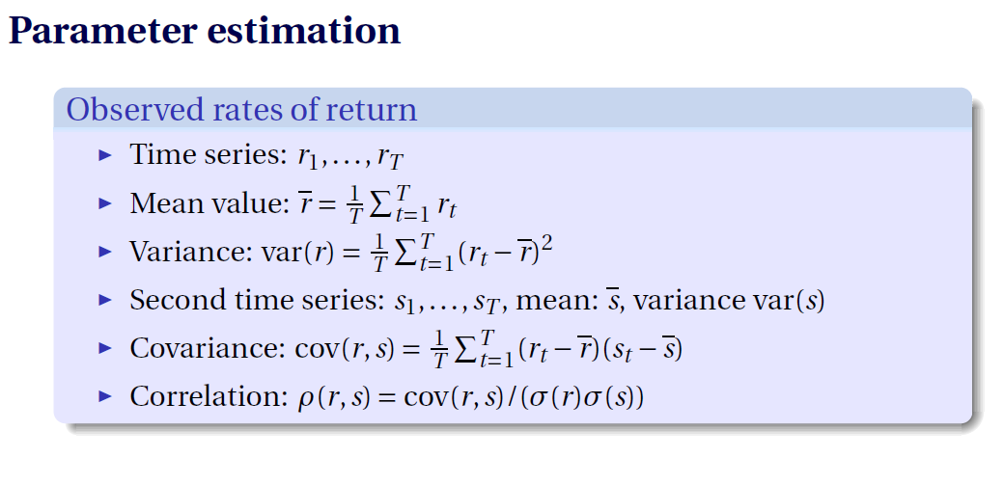

Slide 34
A few more definitions – Moments, Skewness and kurtosis
‘r’th moment for a set of data X1, X2,…,Xn is defined as
( X1^{r} + X2^{r} + … + Xn^{r} )/ n.
Extending this definition to data with respective frequencies
Σ (fi) * (Xi)^{r} / N
Skewness:
Skewness is the degree of asymmetry, or departure from symmetry, of a distribution.
If the frequency curve (smoothed frequency polygon) of a distribution has a longer tail to the right of the central maximum than to the left, the distribution is said to be skewed to the right, or to have positive skewness.
If the reverse is true, it is said to be skewed to the left, or to have negative skewness.

Slide 35
Graphs
Graphs - visual display of data used to present frequency distributions so that the shape of the distribution can easily be seen.
Bar graph - a form of graph that uses bars separated by an arbitrary amount of space to represent how often elements within a category occur. The higher the bar, the higher the frequency of occurrence. The underlying measurement scale is discrete (nominal or ordinal-scale data), not continuous.
Histogram - a form of a bar graph used with interval or ratio-scaled data. Unlike the bar graph, bars in a histogram touch with the width of the bars defined by the upper and lower limits of the interval. The measurement scale is continuous, so the lower limit of any one interval is also the upper limit of the previous interval.
Boxplot - a graphical representation of dispersions and extreme scores. Represented in this graphic are minimum, maximum, and quartile scores in the form of a box with "whiskers." The box includes the range of scores falling into the middle 50% of the distribution (Inter Quartile Range = 75th percentile - 25th percentile)and the whiskers are lines extended to the minimum and maximum scores in the distribution or to mathematically defined (+/-1.5*IQR) upper and lower fences.
Scatterplot - a form of graph that presents information from a bivariate distribution. In a scatterplot, each subject in an experimental study is represented by a single point in two-dimensional space. The underlying scale of measurement for both variables is continuous (measurement data). This is one of the most useful techniques for gaining insight into the relationship between two variables.

Slide 36
Histograms
These are one of the most useful graphical technique in EDA.
These are bar plots of counts vs subgroups of an exposure variable.
Each bar represents the frequency of the cases for the range of values.
These ‘d give an indication of the probability distribution
The range of data for each bar is called ‘bin’.
The best value of bin requires some experiments.

Slide 37
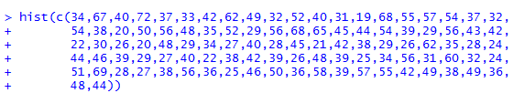
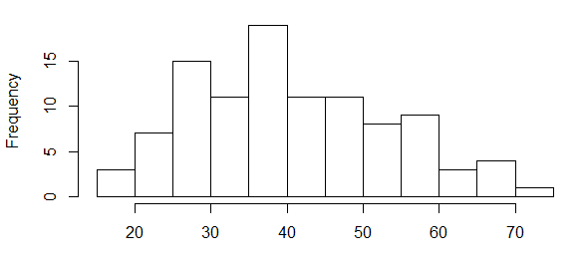
Histogram example
34,67,40,72,37,33,42,62,49,32,52,40,31,19,68,55,57,54,37,32, 54,38,20,50,56,48,35,52,29,56,68,65,45,44,54,39,29,56,43,42, 22,30,26,20,48,29,34,27,40,28,45,21,42,38,29,26,62,35,28,24, 44,46,39,29,27,40,22,38,42,39,26,48,39,25,34,56,31,60,32,24, 51,69,28,27,38,56,36,25,46,50,36,58,39,57,55,42,49,38,49,36,48,44

Slide 38
Population and Sample distribution
Frequency distributions for a variable apply both to a population and to samples from that population. The first type is called the population distribution of the variable, and the second type is called a sample distribution.
In a sense, the sample distribution is a blurry photograph of the population distribution. As the sample size increases, the sample relative frequency in any class interval gets closer to the true population relative frequency.
When a variable is continuous, one can choose class intervals in the frequency distribution and for the histogram as narrow as desired. Now, as the sample size increases indefinitely and the number of class intervals simultaneously increases, with their width narrowing, the shape of the sample histogram gradually approaches a smooth curve. We use such curves to represent population distributions.

Slide 39
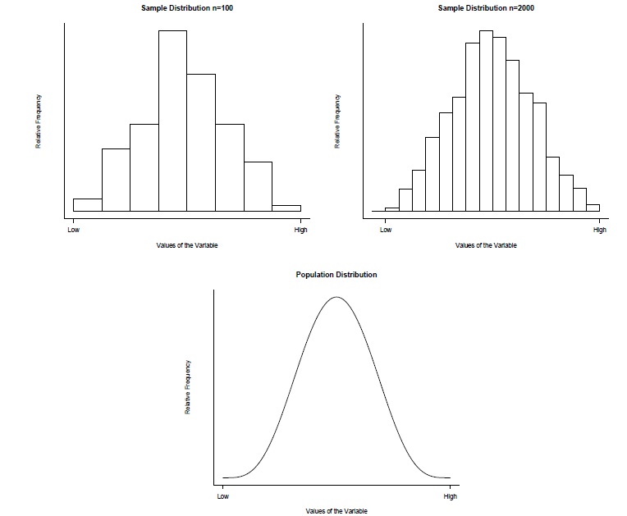
The closer analysis leads us to the concept of probability distribution.

Slide 40
Box plot
The box plot is a useful graphical display for describing the behavior of the data in the middle as well as at the ends of the distributions.
The box plot uses the median and the lower and upper quartiles (defined as the 25th and 75th percentiles). If the lower quartile is Q1 and the upper quartile is Q3, then the difference (Q3 - Q1) is called the interquartile range or IQ.
A box plot is constructed by drawing a box between the upper and lower quartiles with a solid line drawn across the box to locate the median. The following quantities (called fences) are needed for identifying extreme values in the tails of the distribution:
lower inner fence: Q1 - 1.5*IQ
upper inner fence: Q3 + 1.5*IQ
upper outer fence: Q3 + 3*IQ
lower outer fence: Q1 - 3*IQ
A point beyond an inner fence on either side is considered a mild outlier.
A point beyond an outer fence is considered an extreme outlier.

Slide 41
Box plots and outliers
Data:
30, 171, 184, 201, 212, 250, 265, 270, 272, 289, 305, 306, 322, 322, 336, 346, 351, 370, 390, 404, 409, 411, 436, 437, 439, 441, 444, 448, 451, 453, 470, 480, 482, 487, 494, 495, 499, 503, 514, 521, 522, 527, 548, 550, 559, 560, 570, 572, 574, 578, 585, 592, 592, 607, 616, 618, 621, 629, 637, 638, 640, 656, 668, 707, 709, 719, 737, 739, 752, 758, 766, 792, 792, 794, 802, 818, 830, 832, 843, 858, 860, 869, 918, 925, 953, 991, 1000, 1005, 1068, 1441

Slide 42
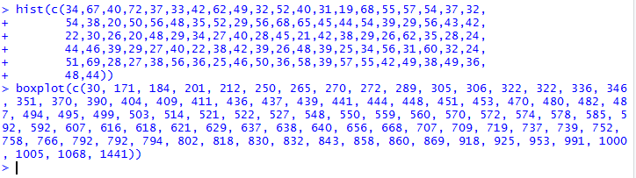
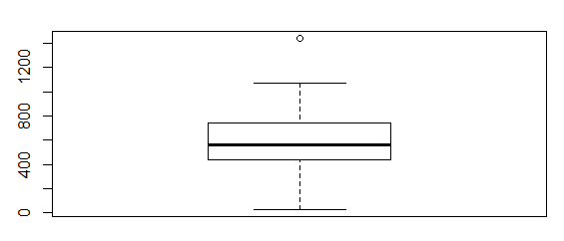
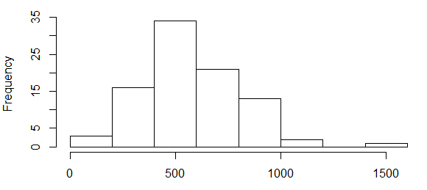
Outliers – Box plot and Histogram

Slide 43
Shapes
Measures of Shape - For distributions summarizing data from continuous measurement scales, statistics can be used to describe how the distribution rises and drops.
Symmetric - Distributions that have the same shape on both sides of the center are called symmetric. A symmetric distribution with only one peak is referred to as a normal distribution.
Skewness - Refers to the degree of asymmetry in a distribution. Asymmetry often reflects extreme scores in a distribution.
Positively skewed - A distribution is positively skewed when is has a tail extending out to the right (larger numbers) When a distribution is positively skewed, the mean is greater than the median reflecting the fact that the mean is sensitive to each score in the distribution and is subject to large shifts when the sample is small and contains extreme scores.
Negatively skewed - A negatively skewed distribution has an extended tail pointing to the left (smaller numbers) and reflects bunching of numbers in the upper part of the distribution with fewer scores at the lower end of the measurement scale.

Slide 44
Kurtosis - Like skewness, kurtosis has a specific mathematical definition, but generally it refers to how scores are concentrated in the center of the distribution, the upper and lower tails (ends), and the shoulders (between the center and tails) of a distribution.
Mesokurtic - A normal distribution is called mesokurtic. The tails of a mesokurtic distribution are neither too thin or too thick, and there are neither too many or too few scores in the center of the distribution.
Platykurtic - Starting with a mesokurtic distribution and moving scores from both the center and tails into the shoulders, the distribution flattens out and is referred to as platykurtic.
Leptokurtic - If you move scores from shoulders of a mesokurtic distribution into the center and tails of a distribution, the result is a peaked distribution with thick tails. This shape is referred to as leptokurtic.

Slide 45
Quantile Normal plot
The final univariate graphical EDA technique is the most complicated.
It is called the quantile-normal or QN plot or more generality the quantile-quantile or QQ plot.
It is used to see how well a particular sample follows a particular theoretical distribution.
Although it can be used for any theoretical distribution, we will limit our attention to seeing how well a sample of data of size n matches a Gaussian distribution with mean and variance equal to the sample mean and variance.
By examining the quantile-normal plot we can detect left or right skew, positive or negative kurtosis, and bimodality.

Slide 46
Q-N plot
Consider the 20 values observed in a study. They happen to have an observed mean of 1.37 and a standard deviation of 1.36.
Ideally, 20 random values drawn from a distribution that has a true mean of 1.37 and sd of 1.36 have a perfect bell-shaped distribution and will be spaced so that there is equal area (probability) in the area around each value in the bell curve.
IN the figure shown these 20 points are expected Normal values.
The sorted actual values are plotted against these expected normal values. Actual values are in X axis.
A straight line is drawn thro the pairs somehow and we could see a few vertical bands which indicate the same measurements.( may be due to rounding)
If many points are on the same side, it amounts to deviation from normality.

Slide 47
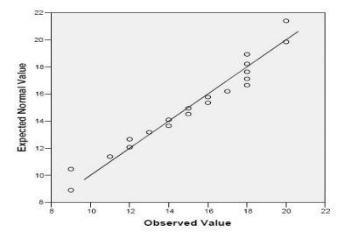

Slide 48
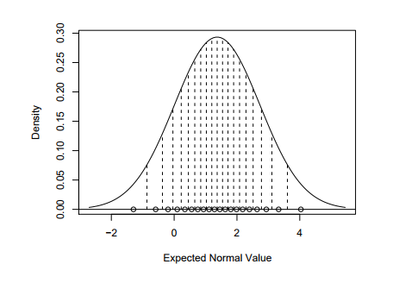
Expected Normal value

Slide 49
Bivariate analysis
Most of the pairs of data elements can be considered comprising of cause and effect. In some cases, they need not be related by cause and effect but just dependence.
There is a need for quantification of this relationship as this could be expected to lead to analysis of multiple dependencies.
This led to the procedures of Bivariate analysis.
For categorical data (and quantitative data with only a few different values) an extension of tabulation called cross-tabulation is very useful.
For two variables, cross-tabulation is performed by making a two-way table with column headings that match the levels of one variable and row headings that match the levels of the other variable, then filling in the counts of all subjects that share a pair of levels.
The two variables might be both explanatory, both outcome, or one of each.
Depending on the goals, row percentages (which add to 100% for each row), column percentages (which add to 100% for each column) and/or cell percentages (which add to 100% over all cells) are also useful.

Slide 50
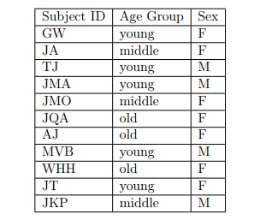
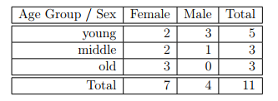
Example
Cross tabulation between age group and sex.
We can easily see that the total number of young females is 2, and we can calculate, e.g., the corresponding cell percentage is 2/11 × 100 = 18.2%, the row percentage is 2/5×100 = 40.0%, and the column percentage is 2/7×100 = 28.6%.

Slide 51

Bivariate analysis (Co variance, auto correlation)
Covariance and correlation measure the degree of relationship between two variables and express how much they change together.
Motivation:
When x increases, if y also increases, their product would also go up almost uniformly.
Point:
We are not taking the product of the actual values but we take the product of the difference between the actual value and the mean.
Hence, it can be expressed as

Slide 52
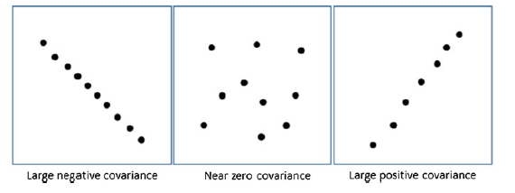
Positive covariance means both variables are moving in the same direction and negative in the opposite direction.
Suppose, two variables have no relationship, (as shown in the mid figure), the covariance tends to move towards Zero.

Slide 53

Covariance - scaling
The drawback is that covariance is scale dependent. To normalize the measure, it is better to divide both numbers (x-xbar) by the respective standard deviations so that the effect of ‘scales’ is removed.
Thus we define ‘correlation coefficient’ between the data vectors x and y as

